Slide 1








A 2-days National Level Hackathon on
AI in education
SELECTED AREA NAME
AICADEMY
RAVINA KUMARI
05/09/2025
SISTec-GN
www.samadhan.sistec.ac.in/

Slide 2

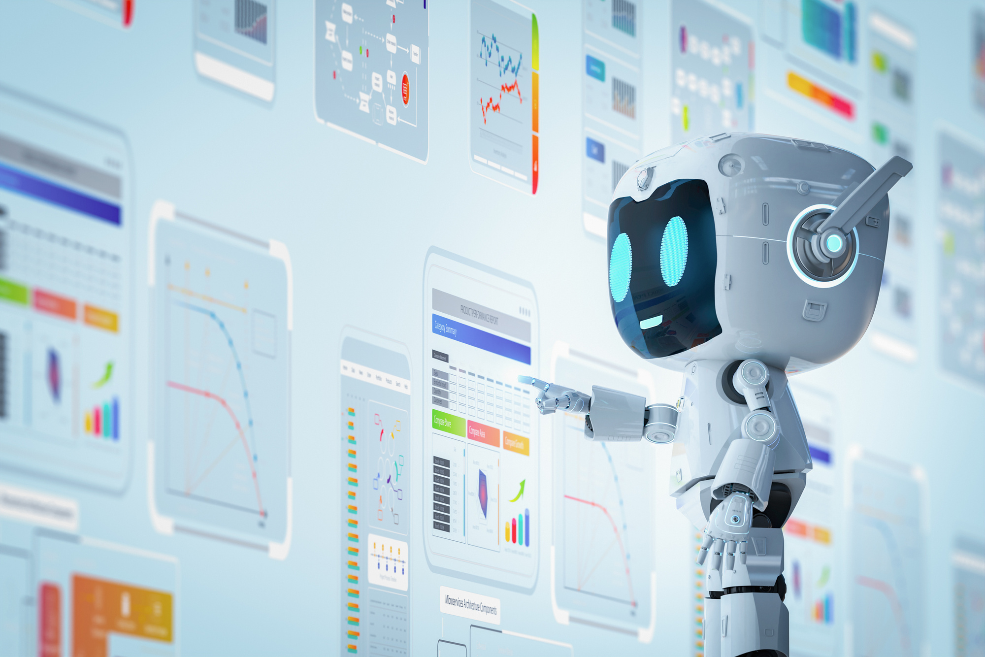
AREA OVERVIEW
Introduction:
Predict student results & guide careers.
Importance of AI:
Early weakness detection.
Personalized learning support.
Benefits:
Better results.
Clear career path.
IMPORTANCE OF AREA
Students often struggle to identify strengths & weaknesses.
Lack of proper guidance affects academic performance.
Career choices become confusing without data-driven insights.
AI can provide accurate predictions & personalized support.

Slide 3
Potential Challenges and Opportunities
Opportunities with AI:
Personalized Learning
Auto Evaluation
Smart Tutoring
Data Insights
Equal Access
Challenges:
Generic Teaching
No Personal Guidance
Manual Evaluation
Progress Tracking Issue
Resource Gap

Slide 4
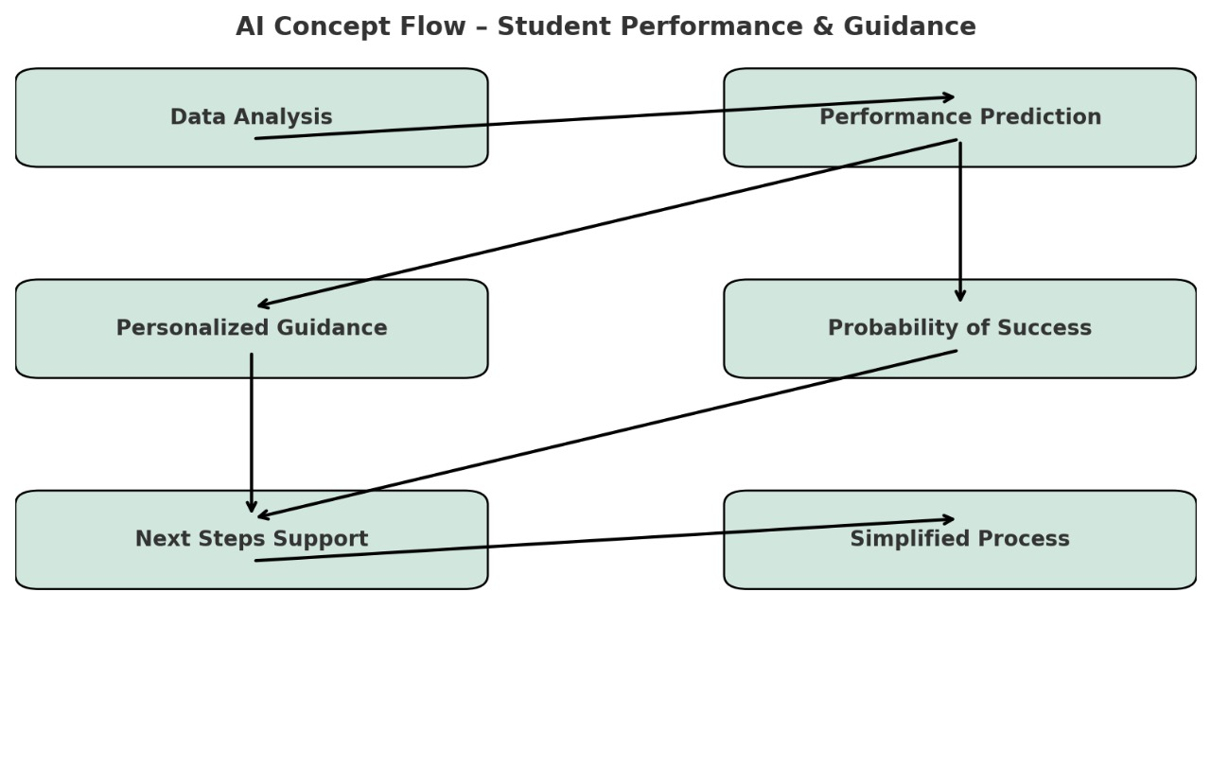
Preliminary Solution Concept
Initial Concept – AI for Student Performance & Guidance:
Data Analysis → Collects marks, attendance, study hours
Performance Prediction → Predict pass/fail or expected score
Personalized Guidance → Suggests suitable career paths
Probability of Success → Shows success chance in each path
Next Steps Support → Recommends courses, skills, internships
Simplified Process → Automates evaluation & progress tracking

Slide 5
Key Features and Functionalities
Personalized Learning – Tailored study plans & recommendations
24/7 Assistance – Doubts resolved anytime
Multilingual Support – Guidance in multiple languages
Automated Evaluation – Quick grading of assignments/tests
Performance Tracking – Progress reports & insights
Career Guidance – Suggested career paths
Interactive Chatbots – Real-time Q&A support

Slide 6
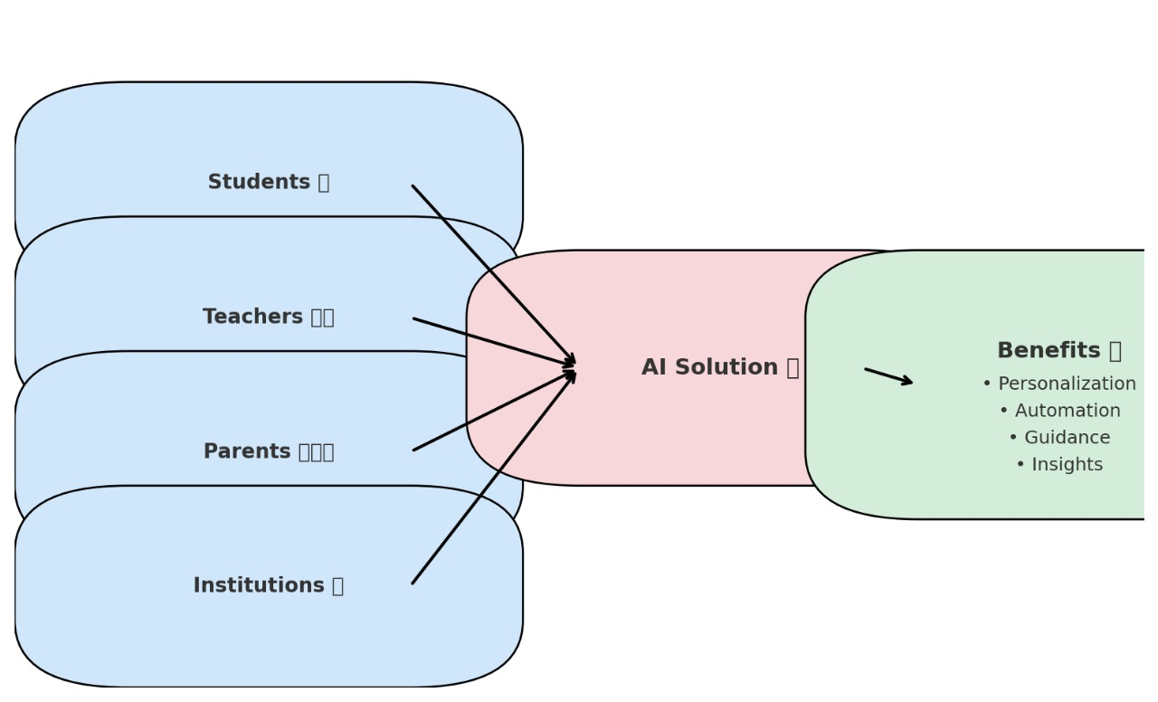
Target Users and Expected Use Cases
Target Users:
Students – For learning support & career guidance
Teachers/Educators – For automated evaluation & progress tracking
Parents – To monitor student performance
Institutions – For data insights & decision-making
Expected Use Cases:
Students asking doubt clarification anytime
Teachers using AI for auto-grading & analytics
Parents checking progress reports
Institutions applying AI for personalized learning plans
Chatbots providing career counseling & study tips

Slide 7
Data Requirements and Privacy Considerations
Data Requirements:
Academic Data – Previous exam marks, attendance, assignments
Behavioral Data – Study hours, learning patterns, course engagement
Career Interests – Subject preferences, future goals
Feedback Data – Teacher & parent feedback
Privacy & Security Considerations:
Data Anonymization – Remove personally identifiable info
Encryption – Protect data during storage & transfer
Access Control – Only authorized users can access sensitive info
Consent-Based Collection – Take permission from students/parents before use
Compliance – Follow education data protection rules (like GDPR, FERPA)

Slide 8
AI Technologies and Methods
Technology / Technique: | Contribution to Effectiveness:
Machine Learning (ML) | Predicts student performance & outcomes
Natural Language Processing | Powers chatbots, understands student queries
Data Analytics | Analyzes performance trends & progress
Recommendation Systems | Suggests personalized study plans & resources
Predictive Modeling | Estimates success probability in different career paths

Slide 9
Implementation Approach
Tools & Resources:
Language: Python
Frameworks: Scikit-learn, TensorFlow
Database: MySQL
NLP: spaCy, NLTK
Deployment: AWS Cloud, Flask
Rough Timeline :
Phase 1 – Problem Understanding & Data Collection
Phase 2 – Data Preprocessing & Model Development (ML + NLP)
Phase 3 – Integration (Backend + Frontend)
Phase 4 – Testing & Validation
Phase 5 – Deployment, Final Touch & Presentation

Slide 10
Evaluation Metrics
Impact:
Better student learning
Clear career guidance
Saves teacher effort
Higher student satisfaction
KPIs:
Prediction accuracy
Fast response time
User engagement
Student improvement
Feedback ratings

